Slide 1
ASP.NET MVC Part I
Ventsislav Popov
Developer Evangelist at Microsoft
ventsypopov.com
ventsypopov.com

Slide 2
Agenda
Beforehand – ASP.NET Web Forms
What is MVC
What is ASP.NET MVC?
Models
Views
Controllers
Validation
Routing
Unit Tests
View engines
ventsypopov.com

Slide 3
ASP.NET Web Forms
Rich controls and tools
Postbacks
Event driven web development
Viewstate
Less control over the HTML
Hard to test
Rapid development
ventsypopov.com

Slide 4
Let’s chat for a bit…
ventsypopov.com

Slide 5
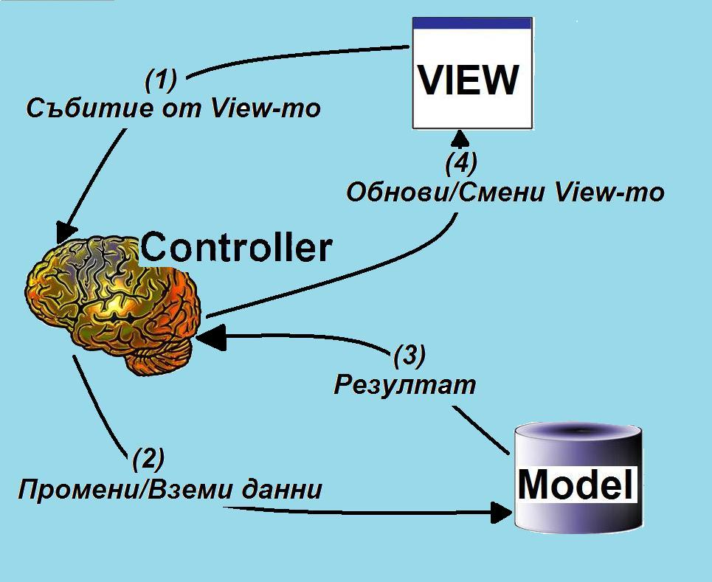
What is MVC
Notes:
Анализ при архитектурни решения – взимаме стратегически решения свързани с бизнес нуждите на системата, която изграждаме. Обмисляме сигурност, производителност, поддръжка, надеждност, интеграция с тестови приложения, леснота и удобство на употреба на системата.
Проблеми, с които се сблъскваме:
Честа смяна на потребителски интерфейс
Различно представяне на едни и същи данни
Работа върху различни устройства
Улеснено модулно тестване на системата
Как да ги решаваме:
Независимост на отделните модули
Преизползваемост на модулите
Добра структурна организация на системата

Slide 6
Model – View - Controller
Controller - responsible for handling all user input
Model - represents the logic of the application
View - the visual representation of the model
ventsypopov.com

Slide 7
ASP.NET MVC
More control over HTML
No Codebehind
Separation of concerns
Easy to test
URL routing
No postbacks
No ViewState
ventsypopov.com

Slide 8
Models
The model should contain all of the application business logic, validation logic, and database access logic.
ASP.NET MVC is compatible with any data access technology (for example LINQ to SQL)
All .edmx files, .dbml files etc. are located in the Models folder.
ventsypopov.com

Slide 9
Custom View Models
When you combine properties to display on a View
namespace ContosoUniversity.ViewModels
{
public class AssignedCourseData
{
public int CourseID { get; set; }
public string Title { get; set; }
public bool Assigned { get; set; }
}
}
ventsypopov.com

Slide 10
Creating a Model - DEMO
ventsypopov.com

Slide 11
What is Controller?
It is a class
Derives from the base System.Web.Mvc.Controller class
Generates the response to the browser request
public class HomeController : Controller
{
public ActionResult Index()
{
ViewBag.Message = "Welcome to ASP.NET MVC!";
return View();
}
public ActionResult About()
{
return View();
}
}
ventsypopov.com

Slide 12
Controller Actions
Public method of the Controller class
Cannot be overloaded
Cannot be a static method
Returns action result
public ActionResult About()
{
return View();
}
ventsypopov.com

Slide 13
Action Results
Controller action response to a browser request
Inherits from the base ActionResult class
Different results types
ventsypopov.com

Slide 14
Implement a Controller - DEMO
ventsypopov.com

Slide 15
Action Results Types
ViewResult
EmptyResult
RedirectResult
JsonResult
JavaScriptResult
ContentResult
FileContentResult
FileStreamResult
FilePathResult
ventsypopov.com
Notes:
Viewresult - If you want an action method to result in a rendered view, the action method should return a call to the controller's View helper method. The View helper method passes a ViewResult object to the ASP.NET MVC framework, which calls the object's ExecuteResult method.
JsonResult - Represents a class that is used to send JSON-formatted content to the response.
JavaScriptResult - Sends JavaScript content to the response.
ContentResult - Represents a user-defined content type that is the result of an action method.
FileContntResult - Represents a class that is used to send binary file content to the response
FileStreamResult - Sends binary content to the response by using a Stream instance.
FilePathResult - Sends the contents of a file to the response

Slide 16
Controller base class methods
View
Redirect
RedirectToAction
RedirectToRoute
Json
JavaScriptResult
Content
File
ventsypopov.com
Notes:
View - Creates a ViewResult object that renders a view to the response.
Redirect - Creates a RedirectResult object that redirects to the specified URL.
RedirectToAction - Redirects to the specified action using the action name
Json - Creates a JsonResult object that serializes the specified object to JavaScript Object Notation (JSON) format.
JavaScript - Creates a JavaScriptResult object
Content - Creates a content result object by using a string.
File - Creates a FileContentResult object by using the file contents and file type.

Slide 17
Views
Most of the Controller Actions return views
The path to the view is inferred from the name of the controller and the name of the controller action.
  \Views\ControllerName\ControllerAction.aspx
A view is a standard (X)HTML document that can contain scripts.
script delimiters <% and %> in the views
ventsypopov.com

Slide 18
Pass Data to a View
With ViewData:
  ViewData["message"] = "Hello World!";
  Strongly typed ViewData:
    ViewData.Model = OurModel;
With ViewBag:
  ViewBag.Message = "Hello World!";
ventsypopov.com

Slide 19
Post data to a controller
  Verb Attributes
  The action method in the controller accepts the values posted from the view.
  The view form fields must match the same names in the controller.
[HttpPost]
public ActionResult Edit(Movie movie)
{
if (ModelState.IsValid)
{
db.Entry(movie).State = EntityState.Modified;
db.SaveChanges();
return RedirectToAction("Index");
}
return View(movie);
}
ventsypopov.com

Slide 20
Explore a View - DEMO
ventsypopov.com

Slide 21
HTML Helpers
Methods which typically return string.
Used to generate standard HTML elements
  textboxes, dropdown lists, links etc.
  Example: Html.TextBox() method
Usage is optional
You can create your own HTML Helpers
ventsypopov.com
Notes:
To create HTML helper – a class with public static string methods and refer the namespace in the view.

Slide 22
Validation
Two types of validation error messages
  generated before the HTML form fields are bound to a class
  generated after the form fields are bound to the class
Model State
Validation Helpers
  Html.ValidationMessage()
  Html.ValidationSummary()
ventsypopov.com
Notes:
Html.ValidationMessage() - Displays a validation message if an error exists for the specified field in the ModelStateDictionary object
Html.ValidationSummary() - Returns an unordered list (ul element) of validation messages that are in the ModelStateDictionary object.

Slide 23
Implement validation- DEMO
ventsypopov.com

Slide 24
Routing
The Routing module is responsible for mapping incoming browser requests to particular MVC controller actions.
Two places to setup:
  Web.config file
  Global.asax file
ventsypopov.com

Slide 25
Routing Setup
Web.config file
<system.web>
<httpModules>
…
<system.webServer> <modules> …
<system.web>
<httpHandlers> …
<system.webServer> <handlers> …
ventsypopov.com

Slide 26
Routing Setup
Global.asax file
public class MvcApplication : System.Web.HttpApplication
{
public static void RegisterRoutes(RouteCollection routes)
{
routes.IgnoreRoute("{resource}.axd/{*pathInfo}");
routes.MapRoute(
"Default",
"{controller}/{action}/{id}",
new { controller = "Home",
action = "Index", id = "" }
);
}
protected void Application_Start()
{
RegisterRoutes(RouteTable.Routes);
}
}
ventsypopov.com

Slide 27
URL Example
http://www.mysite.com/Home/About/6
{controller} = Home
{action} = About
{id} = 6
ventsypopov.com
ventsypopov.com

Slide 28
Routing example - DEMO
ventsypopov.com

Slide 29
Unit Tests
Used for the business logic (not DAL or View logic).
Test individual “unit”of code
Make the code safe to modify
Mock Object framework
  When you lack “real” objects
  Create mocks for the classes in the application
  Test with mock objects
ventsypopov.com

Slide 30
Unit Tests - DEMO
ventsypopov.com

Slide 31
View Engines
Handles the rendering of the view to UI (html/xml);
Different view engines have different syntax
ASP.NET MVC 3 Pre-included View Engines:
  Web Forms
  Razor
ventsypopov.com

Slide 32
View Engines - DEMO
ventsypopov.com

Slide 33
Things to remember
What MVC stands for
How ASP.NET MVC differs from Web Forms
Where is routing configured
How to validate business logic
How to use helpers
Unit tests basics
Choice between “View Engines”
ventsypopov.com

Slide 34
Useful sites
http://www.asp.net/mvc
http://msdn.microsoft.com/en-us/library/dd394709.aspx
http://stackoverflow.com/
http://jquery.com/
ventsypopov.com

Slide 35
ASP.NET MVC
Email: vepopov [at] microsoft.com
Twitter: @v_popov
ventsypopov.com

Slide 36

Time to wake up :)

